Slide 1
Shopping - Lesson 5
Role play preparation

Slide 2
Shopping - Lesson 5 Role play preparation
Learning objectives
Revising shopping strategies
Using formulaic expressions in shopping role plays
Showing creativity in the role play

Slide 3
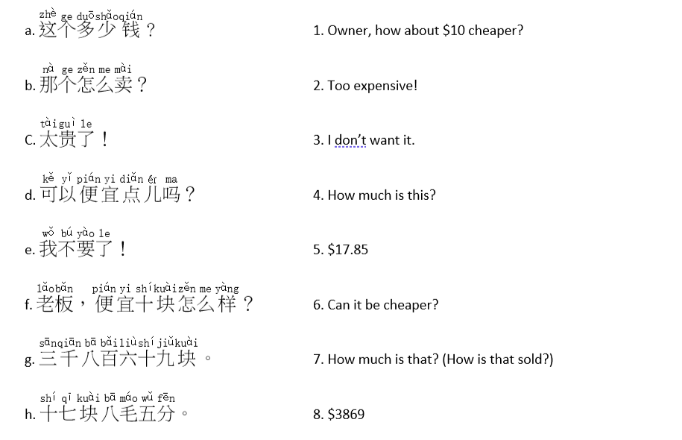
Match the translation

Slide 4
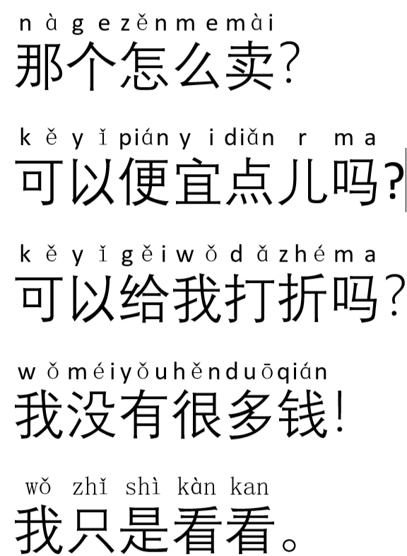
Translation
Extension: English to Chinese
Chinese to English
How much is it?
Too expensive!
I am leaving.
I want to buy ….
Do you have …?

Slide 5
Role play (draft writing)
In pairs, create a 1-minute role play using the above common Chinese phrases for shopping.
Choose 1 of the 6 scenarios on the right. Try not to repeat the scenarios in class.
Be creative and original
Write down as many Chinese shopping phrases as possible. You MUST use colours & prices
You can add additional phrases that you have learnt before.
You can add additional phrases that you have learnt before.
Scenario 1: Clothing shop
Scenario 2: Electronics shop
Scenario 3: Shopping mall
Scenario 4: Night market
Scenario 5: Tourist gift shop
Scenario 6: Traditional Chinese market

Slide 6
Role play draft

Slide 7
Homework
Complete your role play draft
Bring costume & props to class

