Slide 1
Shopping: Clothing items & clolours
Learning objectives:
•Being able to pronounce different colours with increasing confidence
•Describing different colours for clothing items
•Matching the correct image and description of clothing items.
•Building up speaking & reading ability through the “I have who has” game

Slide 2
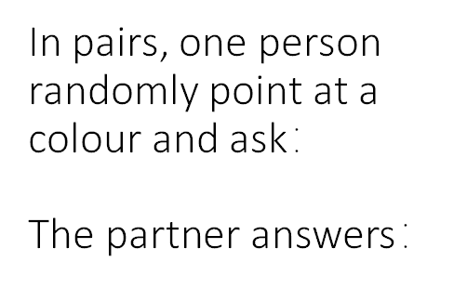
Colours: Speaking exercise

Slide 3
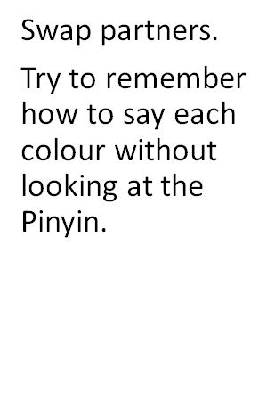
Extension:

Slide 4
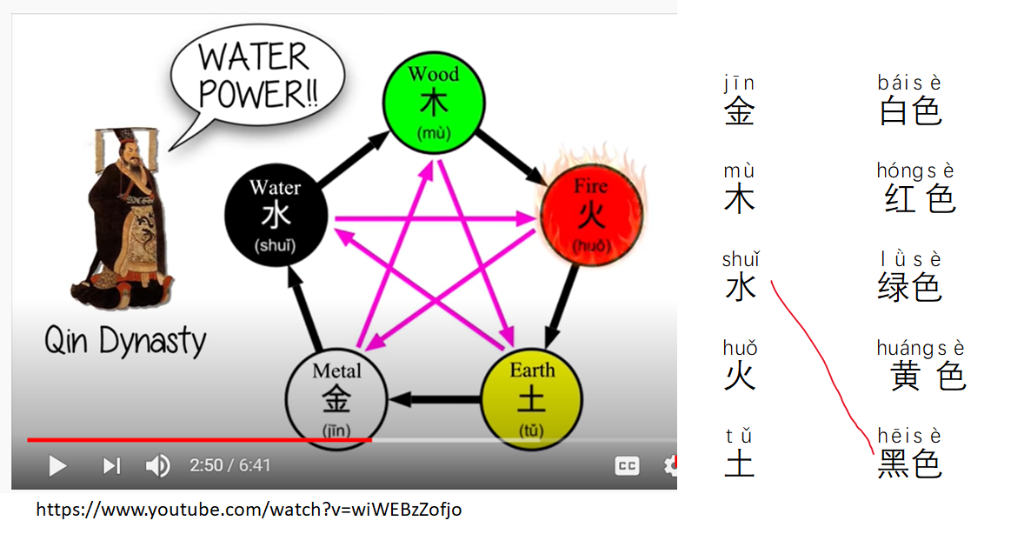
Based on the video from Lesson 1,
match five elements & colours for clothes

Slide 5
Quizlet game: Colours & clothing items
Colours: https://quizlet.com/_84qbw0?x=1jqt&i=ylggh
Clothing items: https://quizlet.com/_8shzuj?x=1jqt&i=ylggh

Slide 6
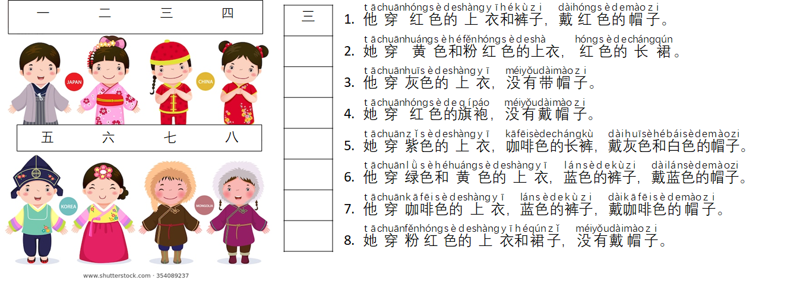
Match the clothing items with the correct description. Write the correct number in the boxes.

Slide 7
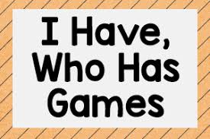
我有…谁有…（I have…who has…)
In pairs, distribute the cards of “colour + clothing items”.
5 cards each.
Use board game phrases to help you communicate with each other in Chinese.
Record the time that your completed the game. See if you can improve the speed.

Slide 8
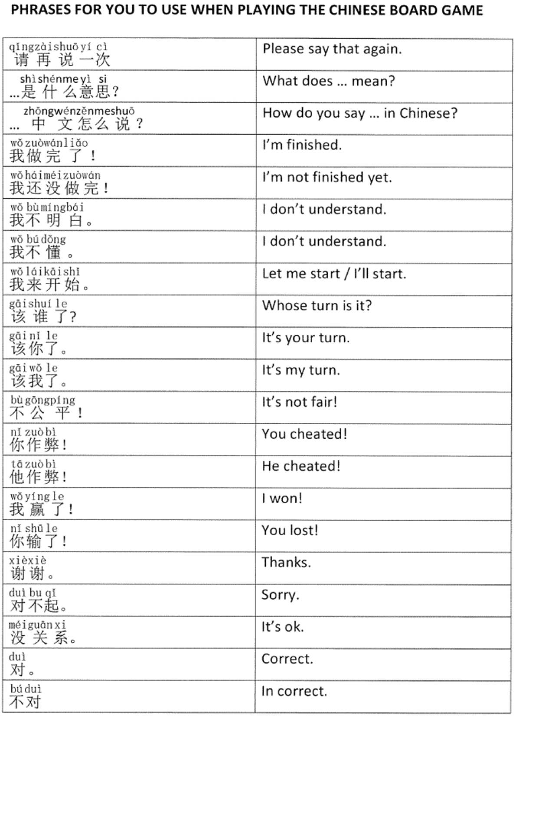

Slide 10
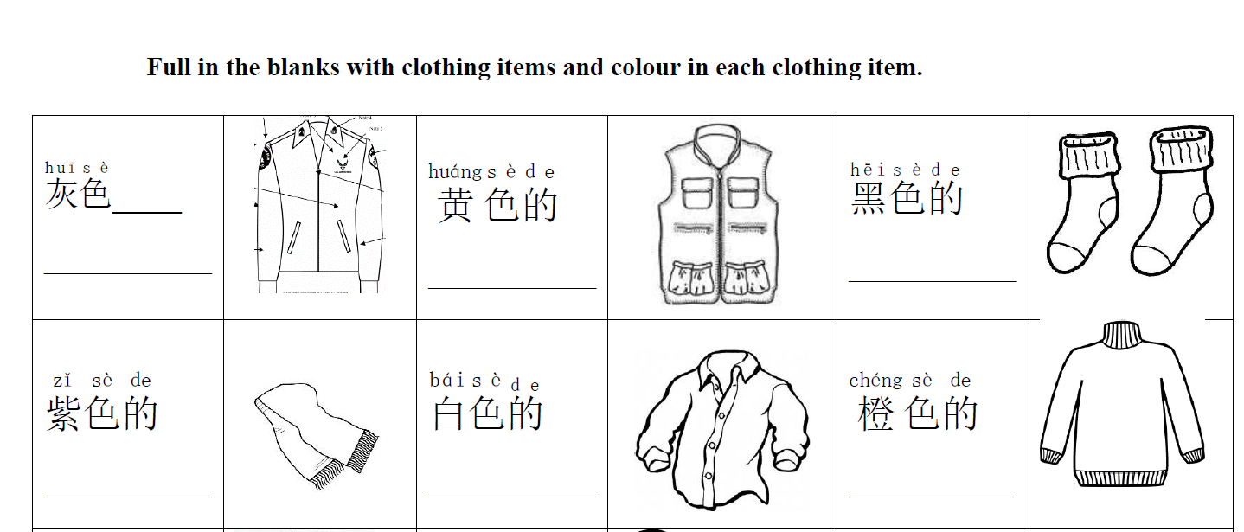
Homework: Colour in & fill in the blanks
Use the vocabulary list or Pleco to help you.
的
上衣 shangyi

