Slide 1
Shopping - Lesson 4 Bargaining strategies
Learning objectives
Revising spot the difference & knowing more about Maori & Taiwanese aboriginal people
Gaining understanding of bargaining strategies in China
Being able to pronounce formulaic expressions in increasing confidence

Slide 2

Zuobian
左边
left
Youbian
右边
right

Slide 3
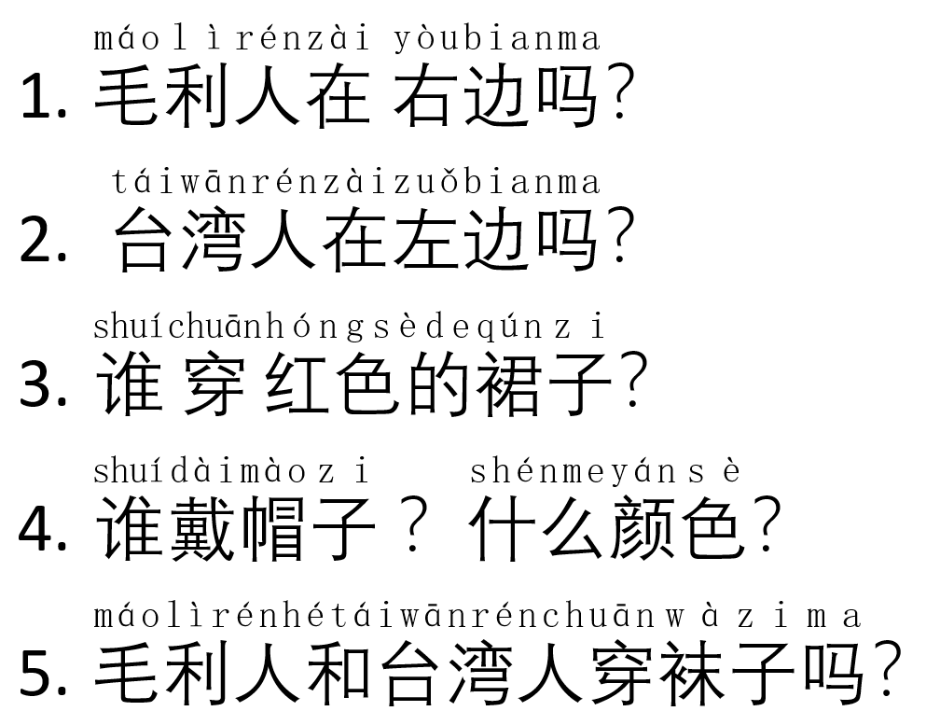
Do now: Based on the previous pictures, answer the following questions in Chinese.

Slide 4
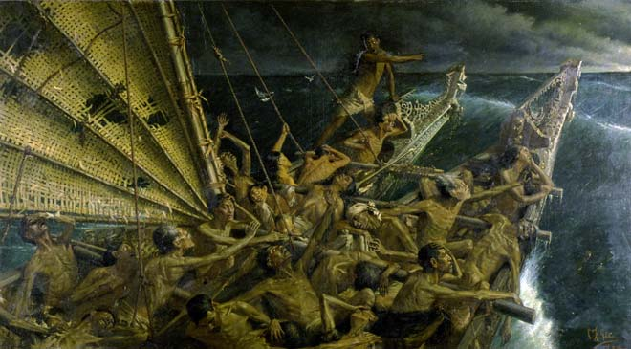
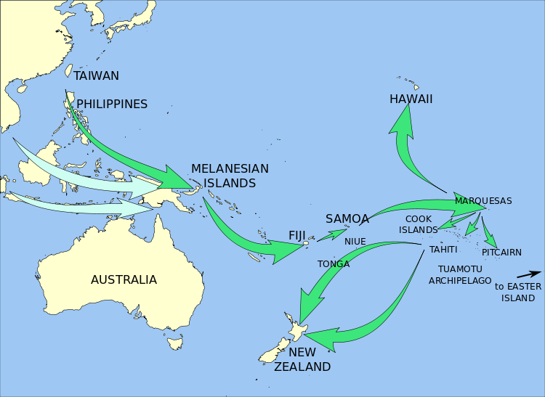
台湾 Taiwan
huachuan
划船
新西兰 xinxilan

Slide 5
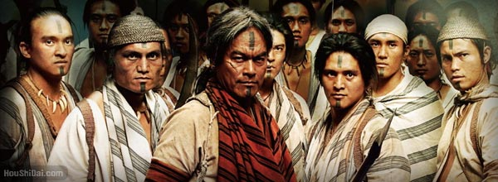



Youbian
右边
right
Zuobian
左边
left

Slide 6
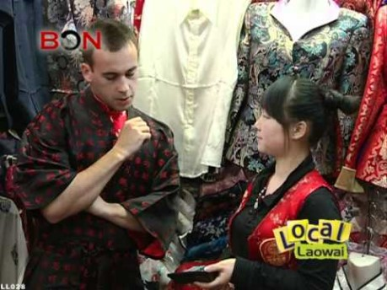
Bargaining strategies in China Watch the video and answer the following questions.

Slide 7
Answer the following questions:
1. Why is bargaining important in China?
2. What is the name of the famous shopping mall?
3. Tips before bargaining: (fill in the blanks)
1) Familiarising yourself with _______________
2) Don't let on that _________________________
3) Do ________________before you come

Slide 8
Tips during bargaining
1) ________________when opening the bargaining
2) Ask the price: Try NOT to ________________
3) Too expensive = __________________(in Chinese)
4) Make it cheaper = ________________(in Chinese)
5) Play __________
6) Asking for discounts: e.g.
打五折= 50% off,
打六折= 40% off,
打七折=_________,
打八折=__________,
打九折=__________

Slide 9
7) Mention you _______________
8) Name a price =
___________________(in Chinese)
9) ￥400 =__________(in Chinese)
10) Lowest =________(in Chinese)
11) Money = ________(in Chinese)
12) If all else fails, __________________________________
13) Chinese friends can often _________________________

Slide 10

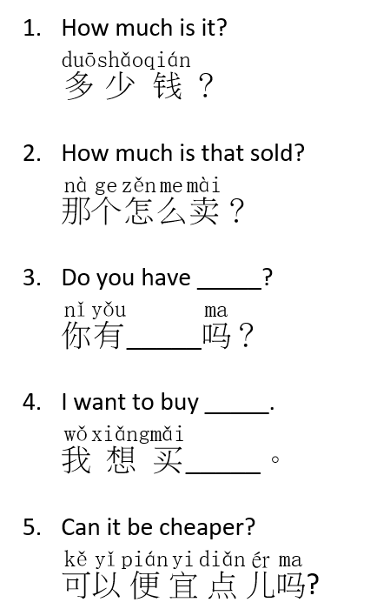
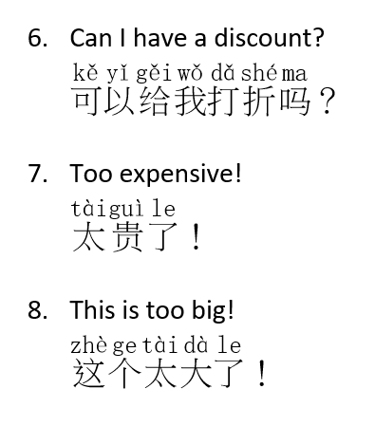
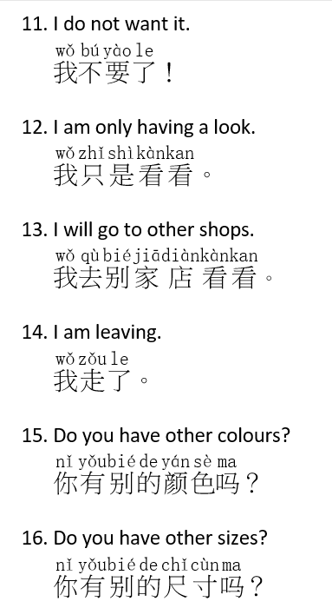
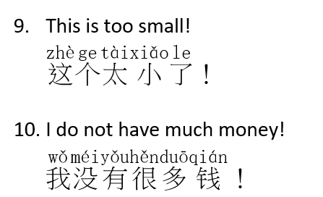
Common Shopping Phrases in Chinese

Slide 11
Competition 比赛 （bisai)
In groups of 3-4, put your hand up if you can read or translate the following shopping strategies.
一分： Read shopping strategies with minor mistakes
两分： Read shopping strategies with clear pronunciation.
一分： Translate shopping strateggies into English.
The group which obtained the highest points win.

Slide 12


Slide 13
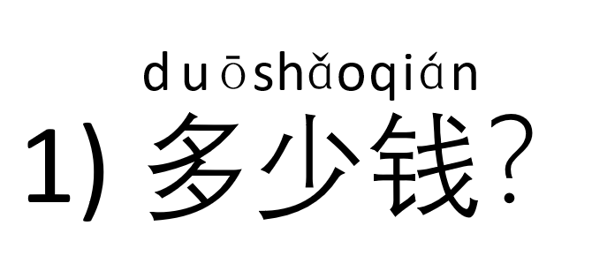

Slide 14
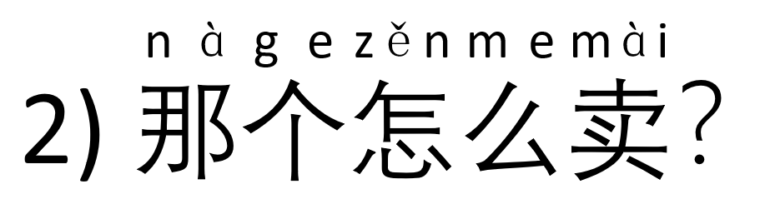

Slide 15
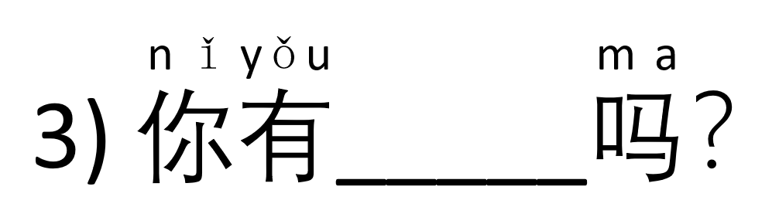

Slide 16
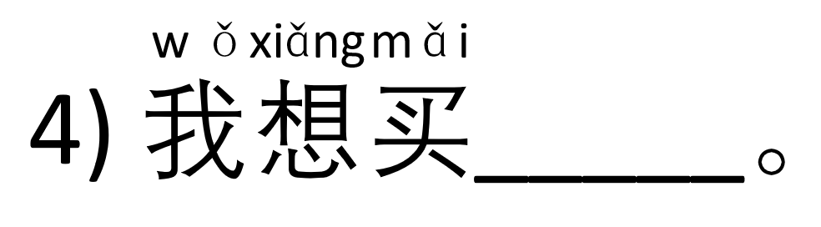

Slide 17
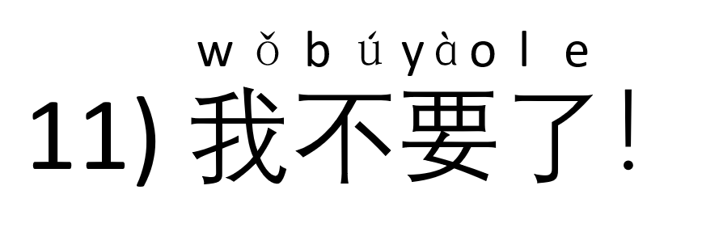

Slide 18
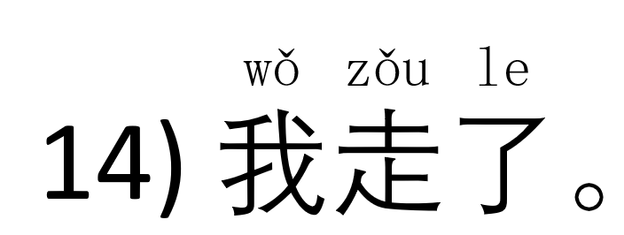

Slide 19


Slide 20


Slide 21


Slide 22
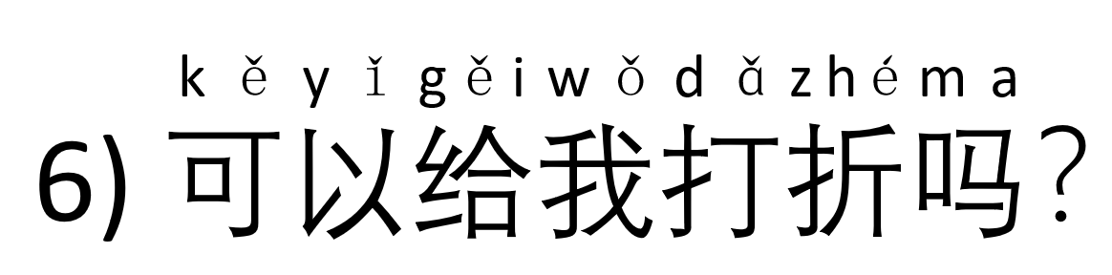

Slide 23
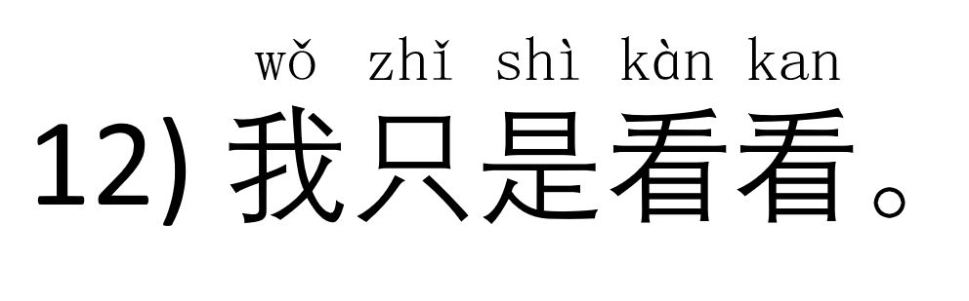

Slide 24
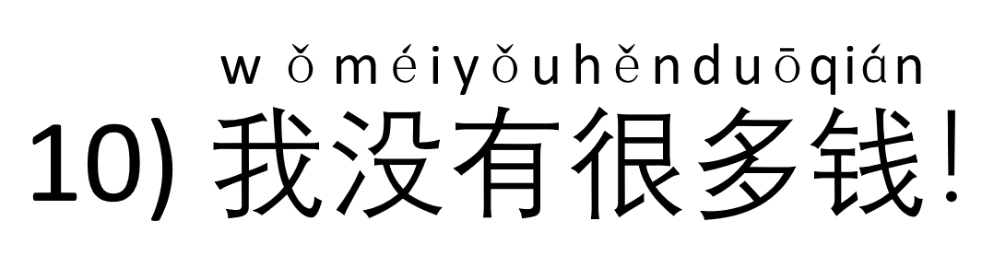

Slide 25
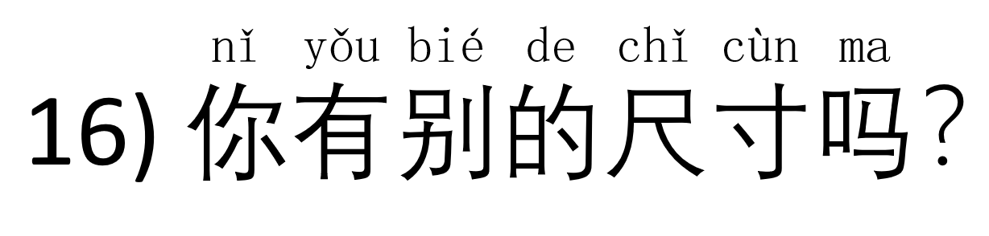

Slide 26
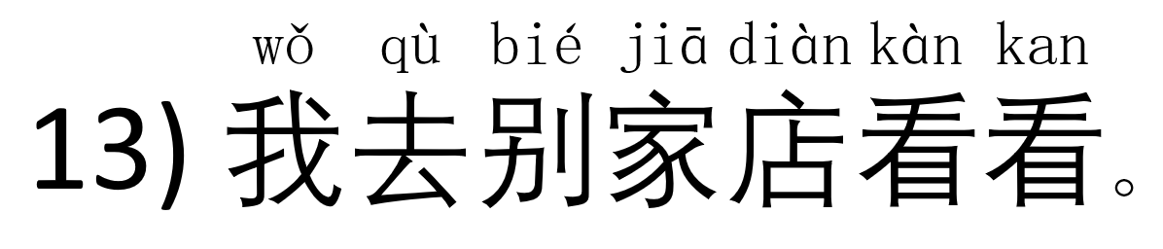

Slide 27
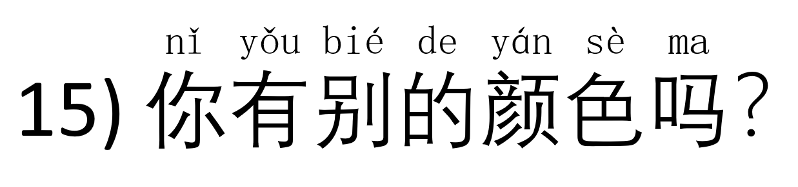

Slide 28
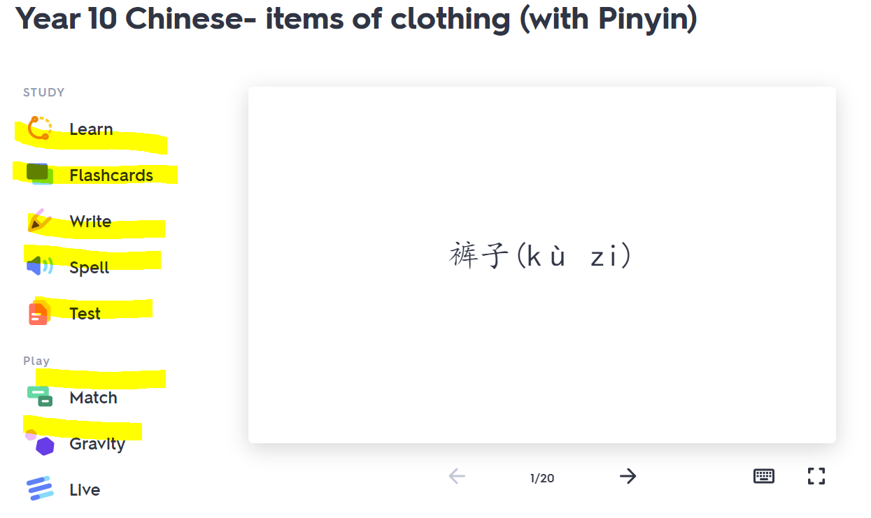
Homework (reminder from previous lessons)
Quizlet revision games on colours & clothing items
Colours: https://quizlet.com/_84qbw0?x=1jqt&i=ylggh
Clothing items: https://quizlet.com/_8shzuj?x=1jqt&i=ylggh

