Slide 1
Shopping - Lesson 3
Spot the difference

Slide 2
Learning objectives
Being able to link colours with clothing items
Spotting differences between 2 similar images
Understanding an old Chinese comics, Old Master Q, and its character 大番薯（dafanshu)
Writing with specific details, including colour + object

Slide 3
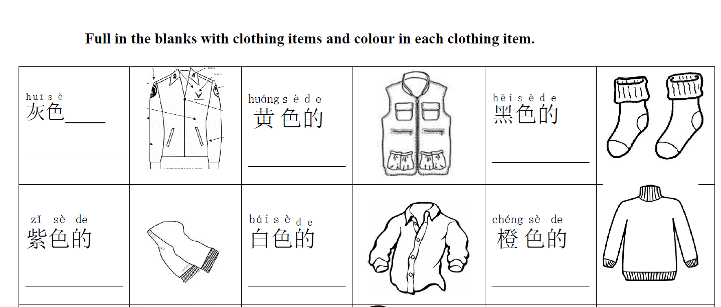
Homework from last lesson: Colour in & fill in the blanks
Use the vocabulary list or Pleco to help you.
的
上衣 shangyi

Slide 4
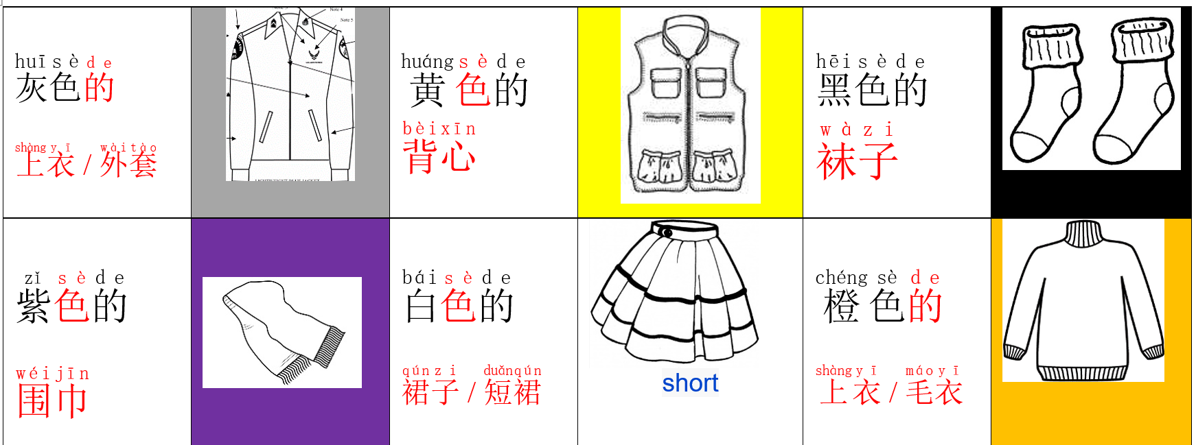
Q: zhe shi shenme A: zhe shi de .
这 是 什么？ 这 是 clour 的 clothing item.
Notes:
Teacher randomly points at a picture and asks “zheshishenme? Students will put the hand up to say the correct answer.

Slide 5
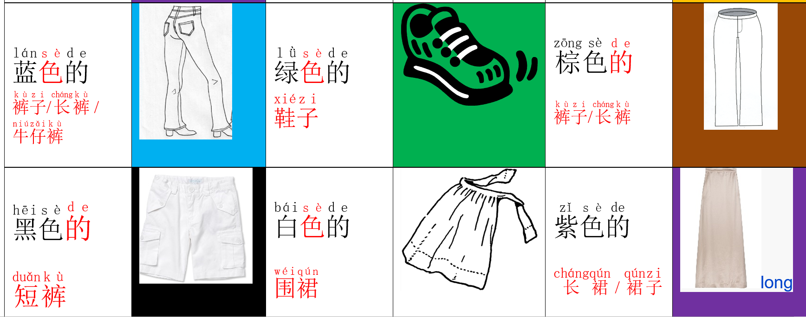
Q: zhe shi shenme A: zhe shi de .
这 是 什么？ 这 是 clour 的 clothing item.
Notes:
Ask a student to be the teacher and randomly points at a picture and asks “zheshishenme? Students will put the hand up to say the correct answer.

Slide 6
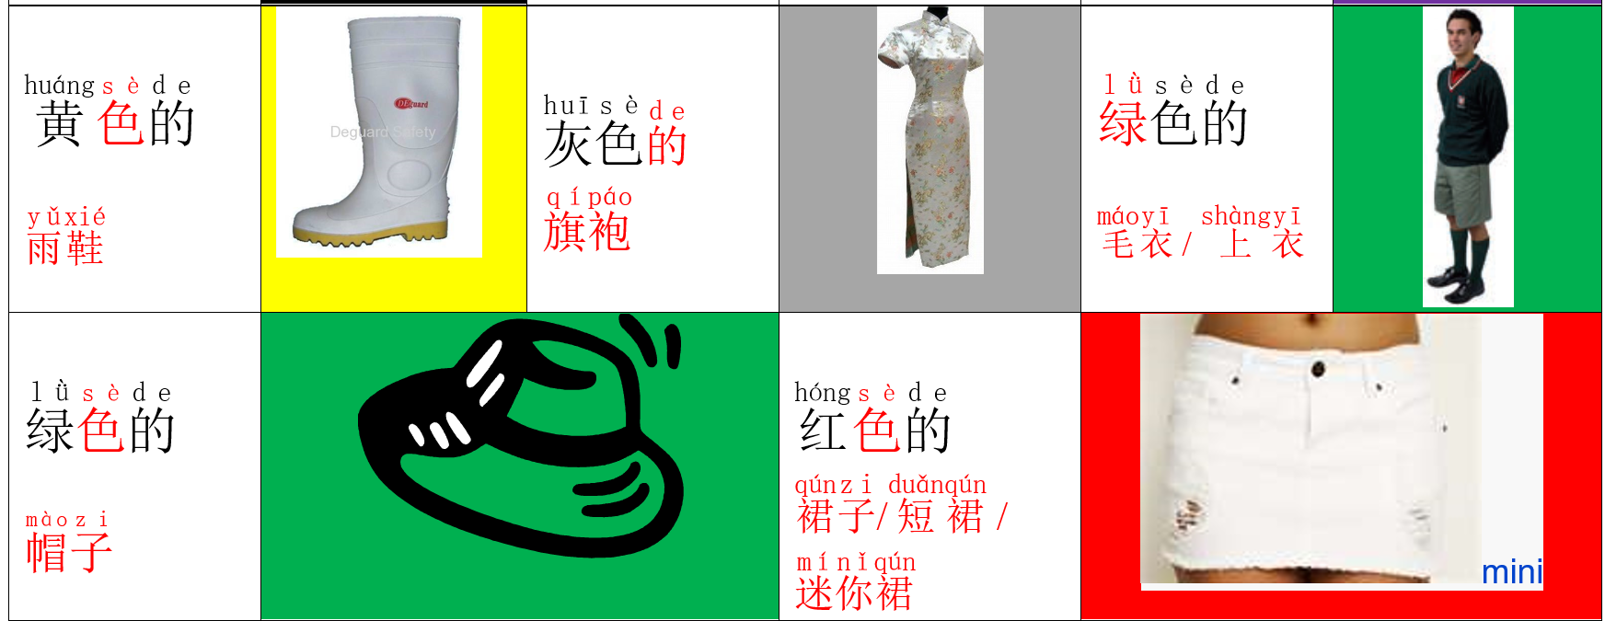
Q: zhe shi shenme A: zhe shi de .
这 是 什么？ 这 是 clour 的 clothing item.
Notes:
Ask a student to be the teacher and randomly points at a picture and asks “zheshishenme? Students will put the hand up to say the correct answer.

Slide 7
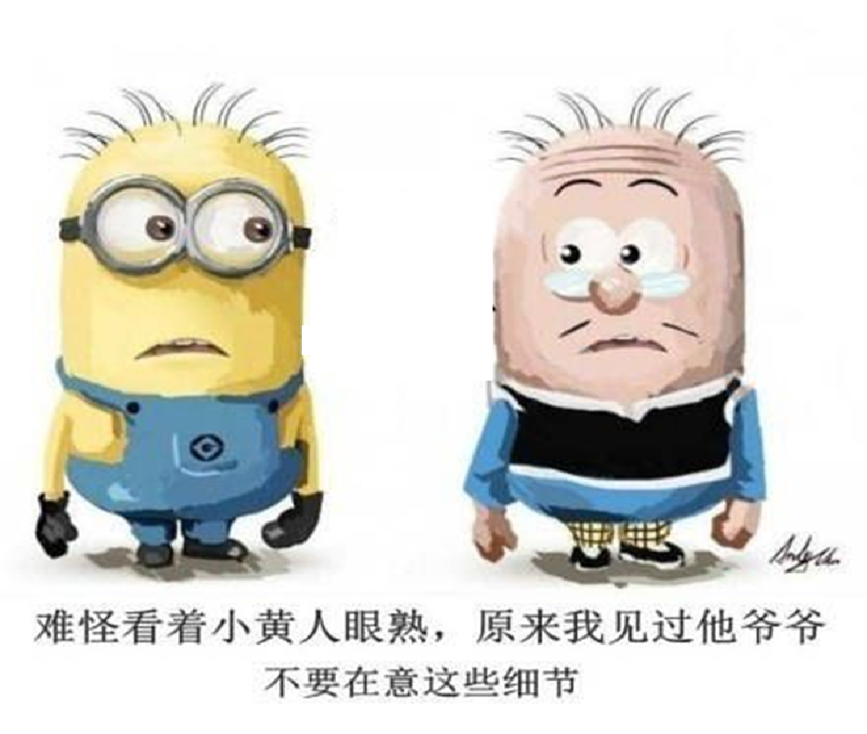
Spot the difference between left & right
Zuobian / youbian chuan dai
左边 /右边 +穿 / 戴 colour 的 clothing items
Zuobian
左边
left
Youbian
右边
right
Notes:
Teacher asks students to spot the difference between 左边 and 右边。

Slide 8
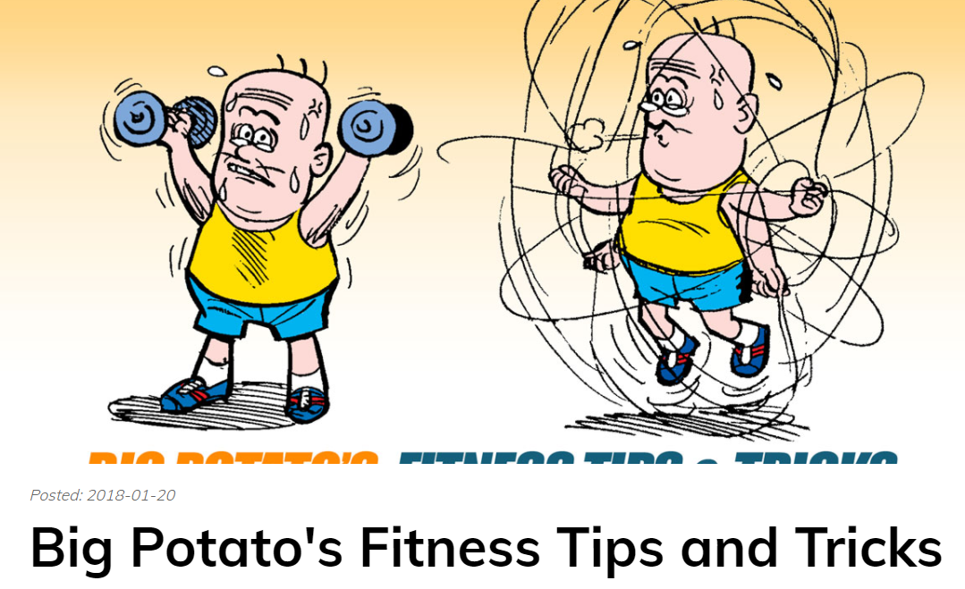
老夫子 laofuzi comics Old Master Q
大番薯 dafanshu
Big Kumara
https://www.oldmasterq.com/
Notes:
https://www.oldmasterq.com/

Slide 9
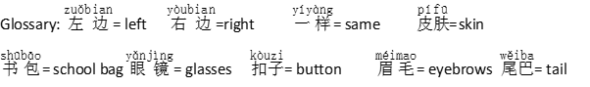
Teacher guided 老师教 （laoshi jiao): Write down 3 differences
Characters | 左(zuǒ)边(bian) | 右(yòu)边(bian)
小(xiǎo)黄(huáng)人(rén) 和(hé) 大(dà)番(fān)薯(shǔ) | · 戴(dài)大(dà)眼(yǎn)镜(jìng) · | · 戴(dài)小(xiǎo)眼(yǎn)镜(jìng) ·

Slide 10
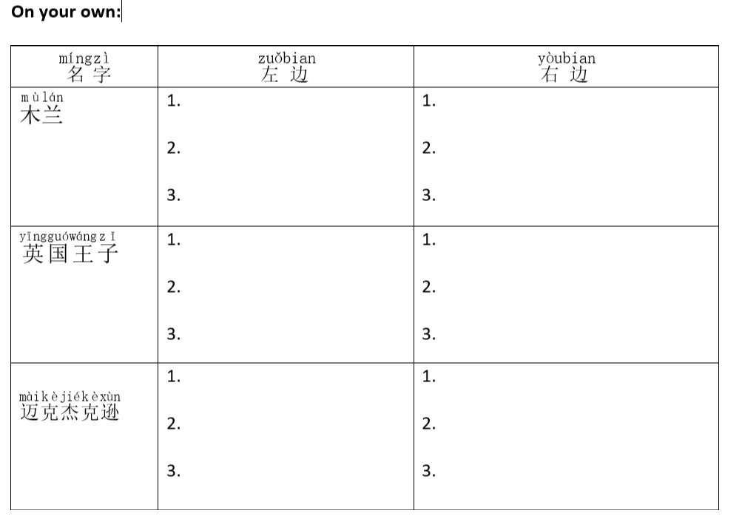
In pairs 两个人 （liang ge ren)

Slide 11
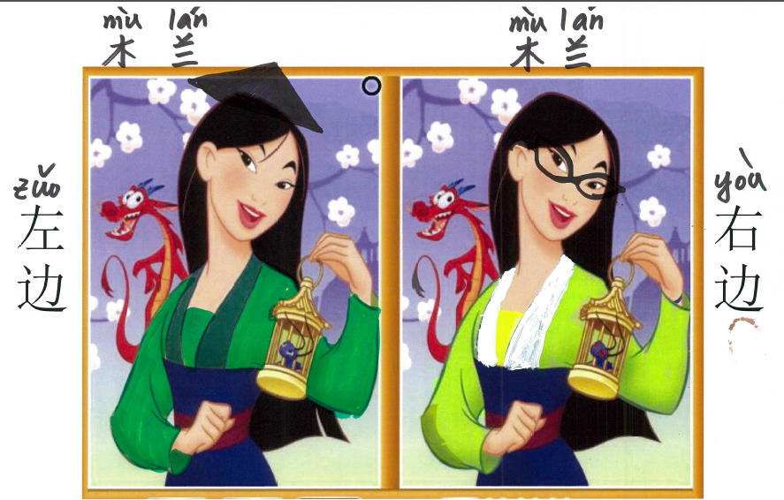

Slide 12
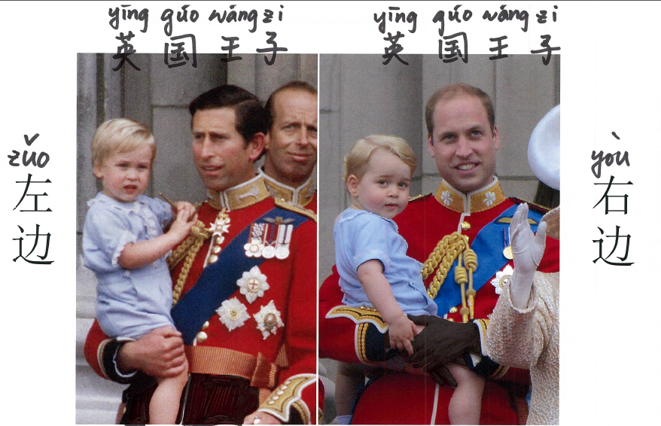
左边
右边

Slide 13
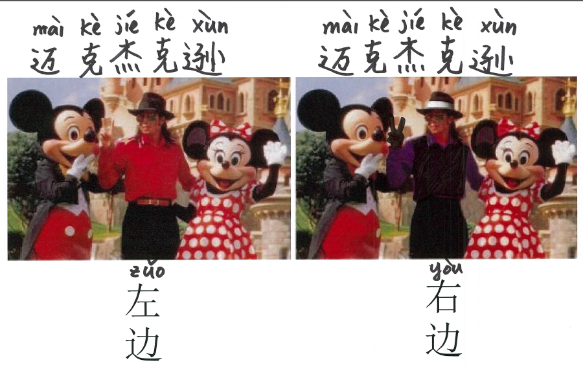

Slide 14
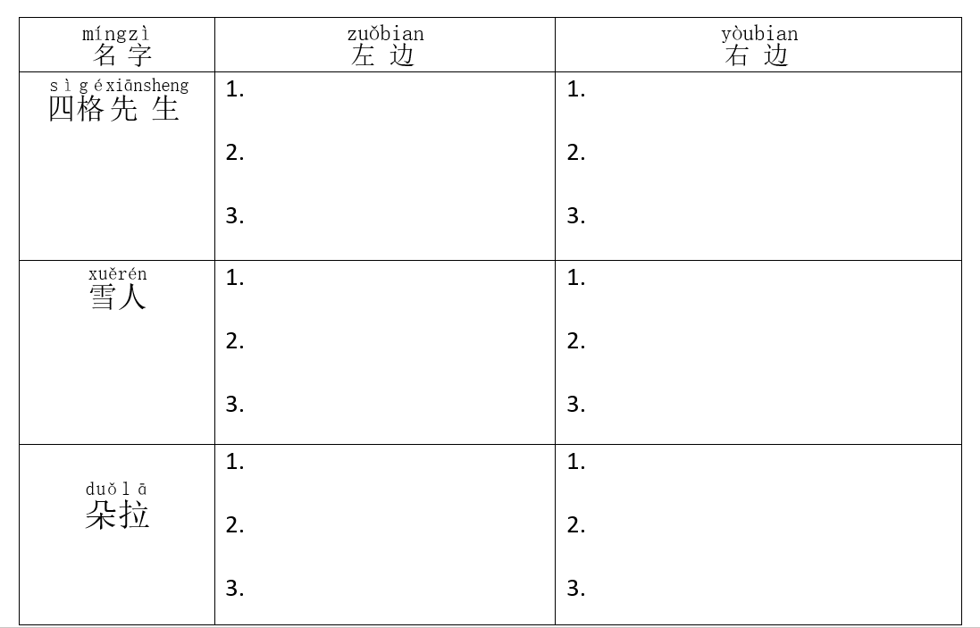
On your own 自己 （ziji)

Slide 15
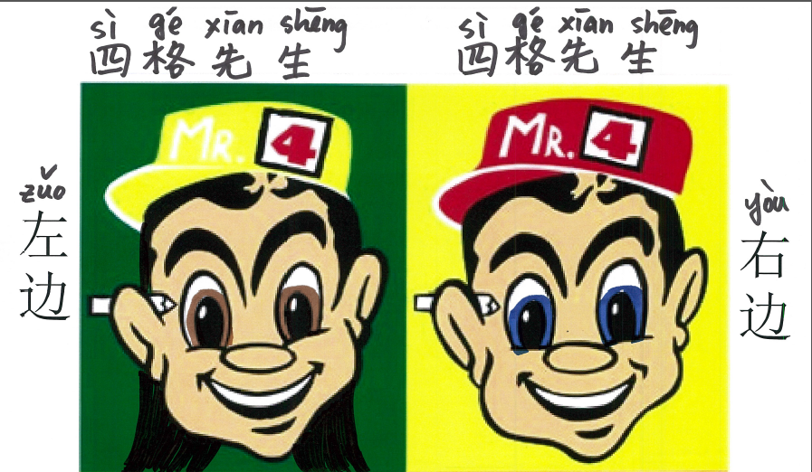

Slide 16
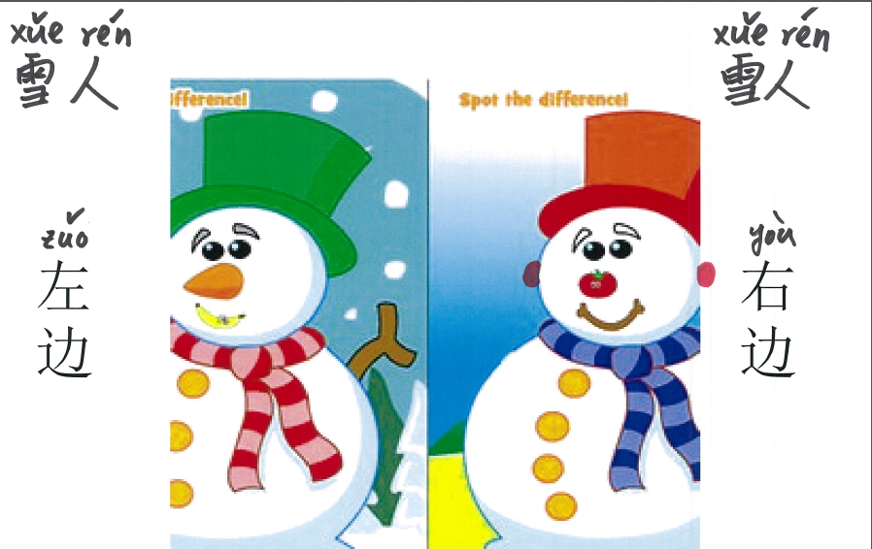

Slide 17
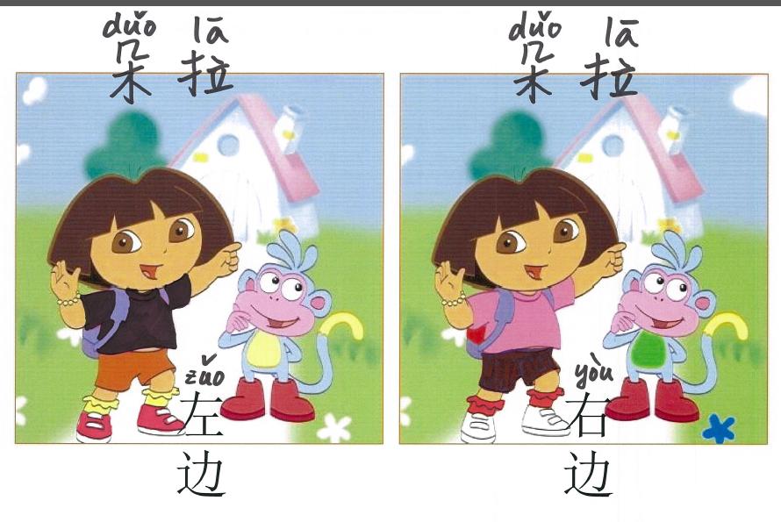

Slide 18
Homework
Complete the writing of spot the difference

Slide 19
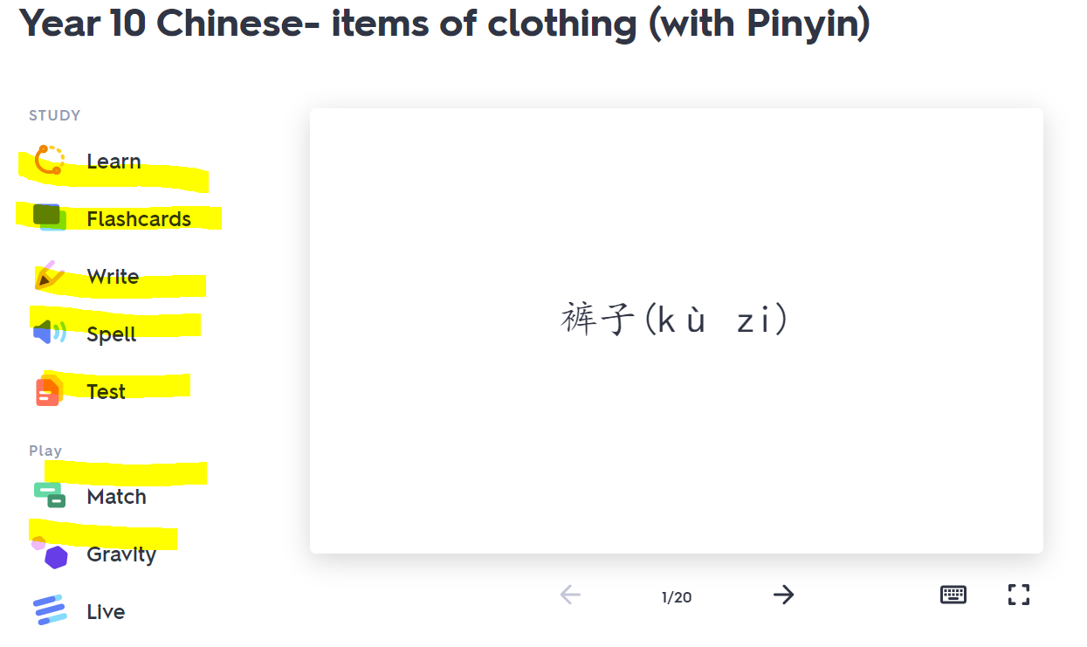
Homework (reminder from previous lessons)
Quizlet revision games on colours & clothing items
Colours: https://quizlet.com/_84qbw0?x=1jqt&i=ylggh
Clothing items: https://quizlet.com/_8shzuj?x=1jqt&i=ylggh

