Slide 1
Shopping – Lesson 1 Clothing items
Learning objectives
Being familiar with clothing items & accessories
Using the correct verb to indicate wearing a clothing item or accessory
穿chuan + clothing item
戴 dai + accessory
Understanding of Ancient Chinese clothing

Slide 2
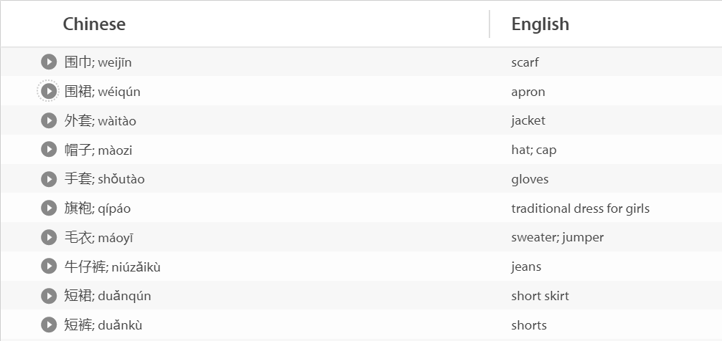
Education Perfect Vocabulary List

Slide 3
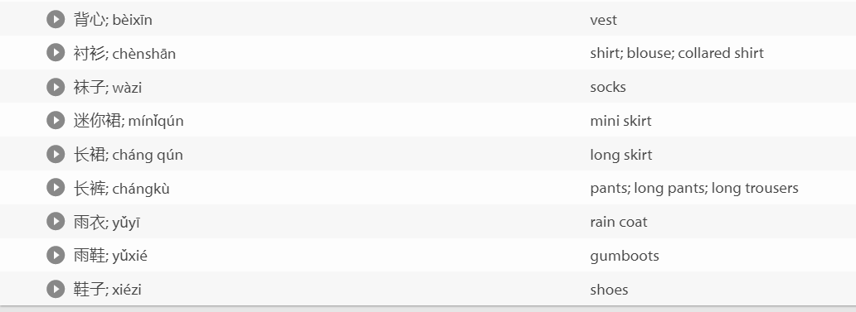

Slide 4
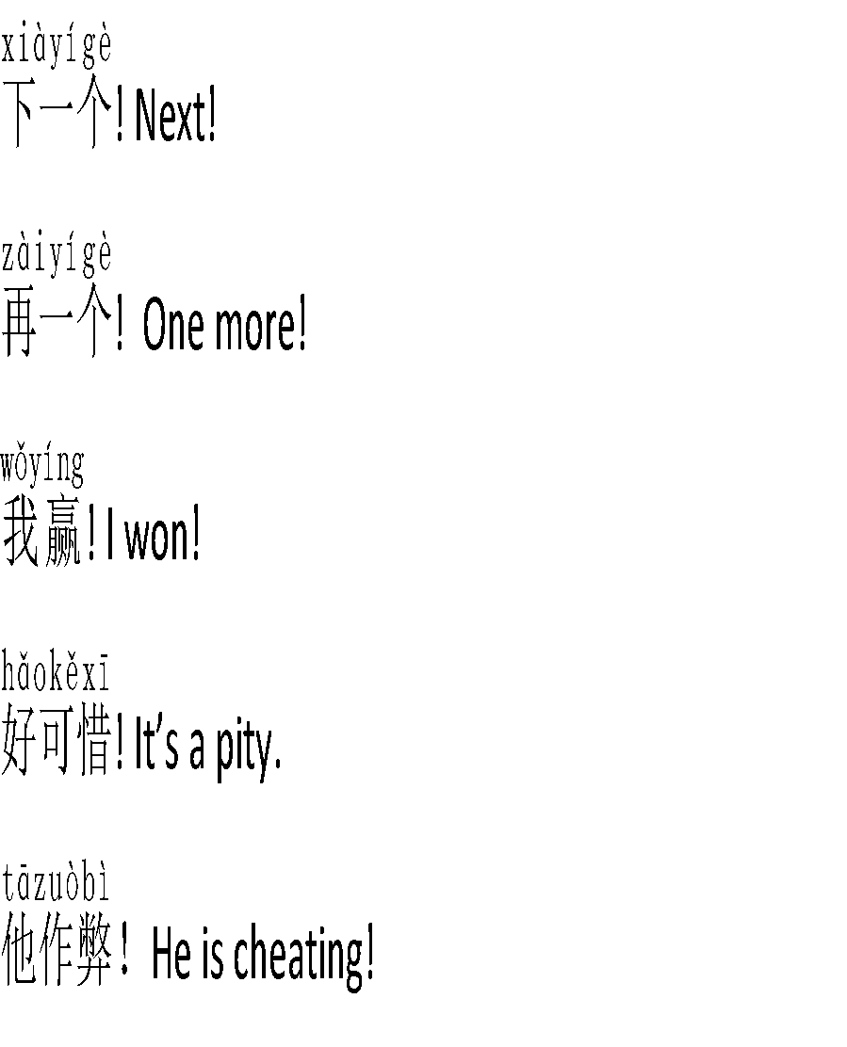
Bingo in Chinese Randomly fill in the blanks with clothing item vocabulary. Link 3 objects to form a line. Make 3 lines to win. You should use as many Chinese board game phrases as you can. Teacher can nominate a student to call the vocabulary.

Slide 5
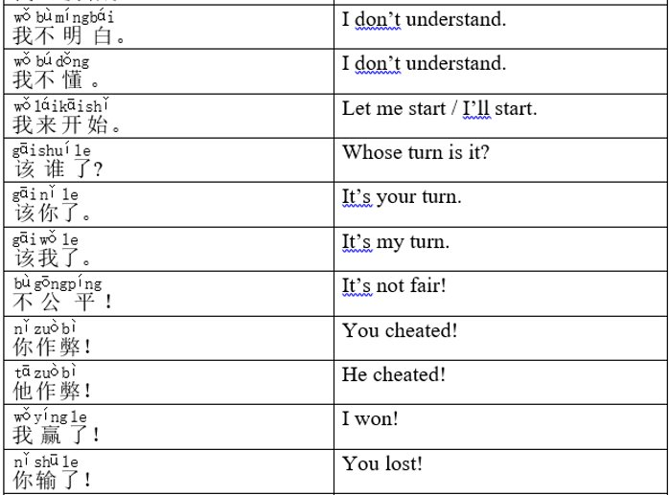
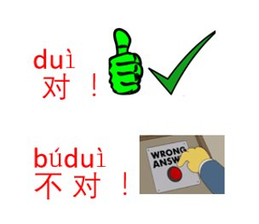
Board game expressions

Slide 6
Winter Clothing Items & Accessories:

Slide 7
Summer clothing items & accessories:

Slide 8
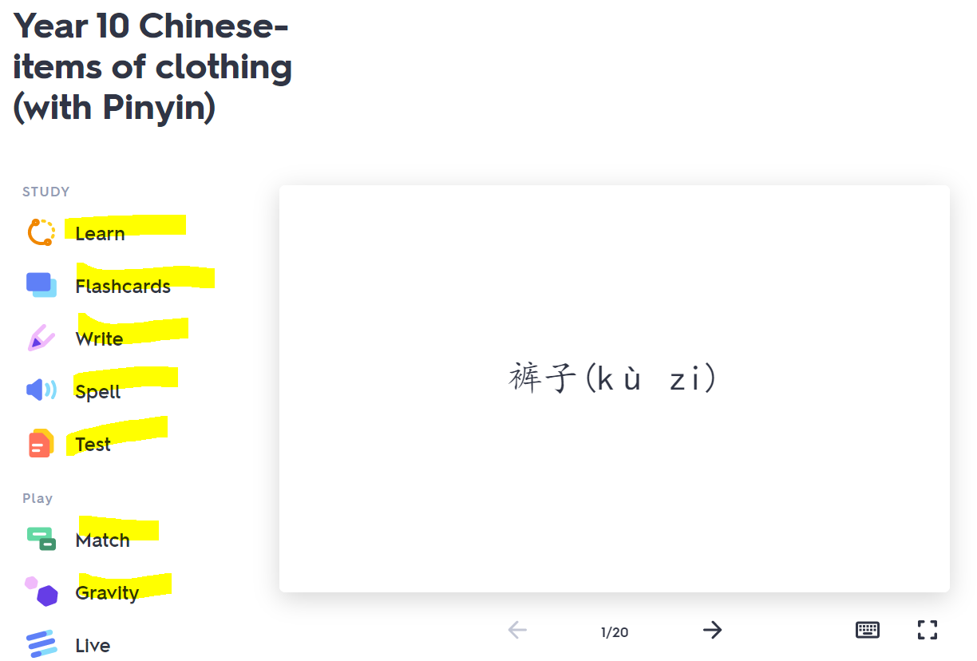
Quizlet
Play Quizlet Live in Teams in class
https://quizlet.com/_8shzuj?x=1qqt&i=ylggh
Revision games (extension)

Slide 9
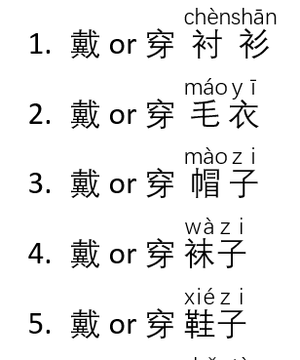
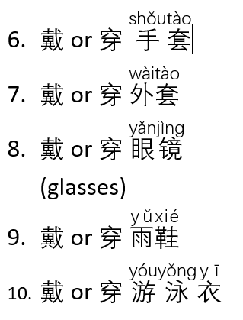
To wear: 穿 chuan vs 戴 dai 穿 + clothing items, socks & shoes 戴 + accessories Which verb is correct for the following clothing items? Circle the correct verb.

Slide 10
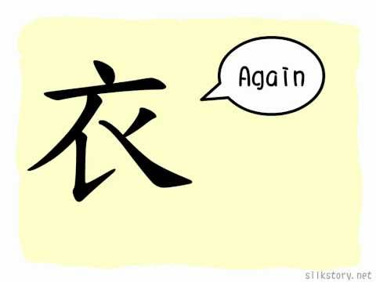
What character/ radical did you see in many clothing items? e.g. 袜子，上衣，毛衣

Slide 11
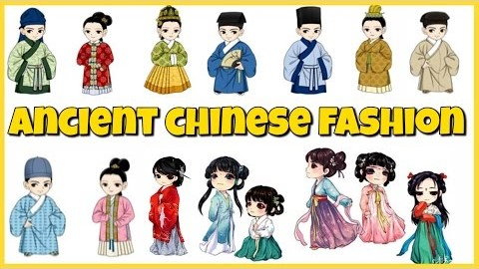
Ancient Chinese Fashion: Did men really wear skirts in China?

Slide 12
Reflection
Why did men wear skirts in Ancient China?
What’s your first impression of knowing that men wore skirts in Ancient China? Why?
What dynasties & relevant clothing items can you remember?
What colours are dominant in Ancient Chinese clothes?
On what occasions, would Chinese people wear traditional style of clothes?

Slide 13
Homework
Quizlet / Education Perfect vocabulary list

